Slide 1
Data Preprocessing
Mr. Shrikrishna Anand Narvekar
Assitant Professor
Computer Engineering department
Agnel Institute of Technology and Design

Slide 2
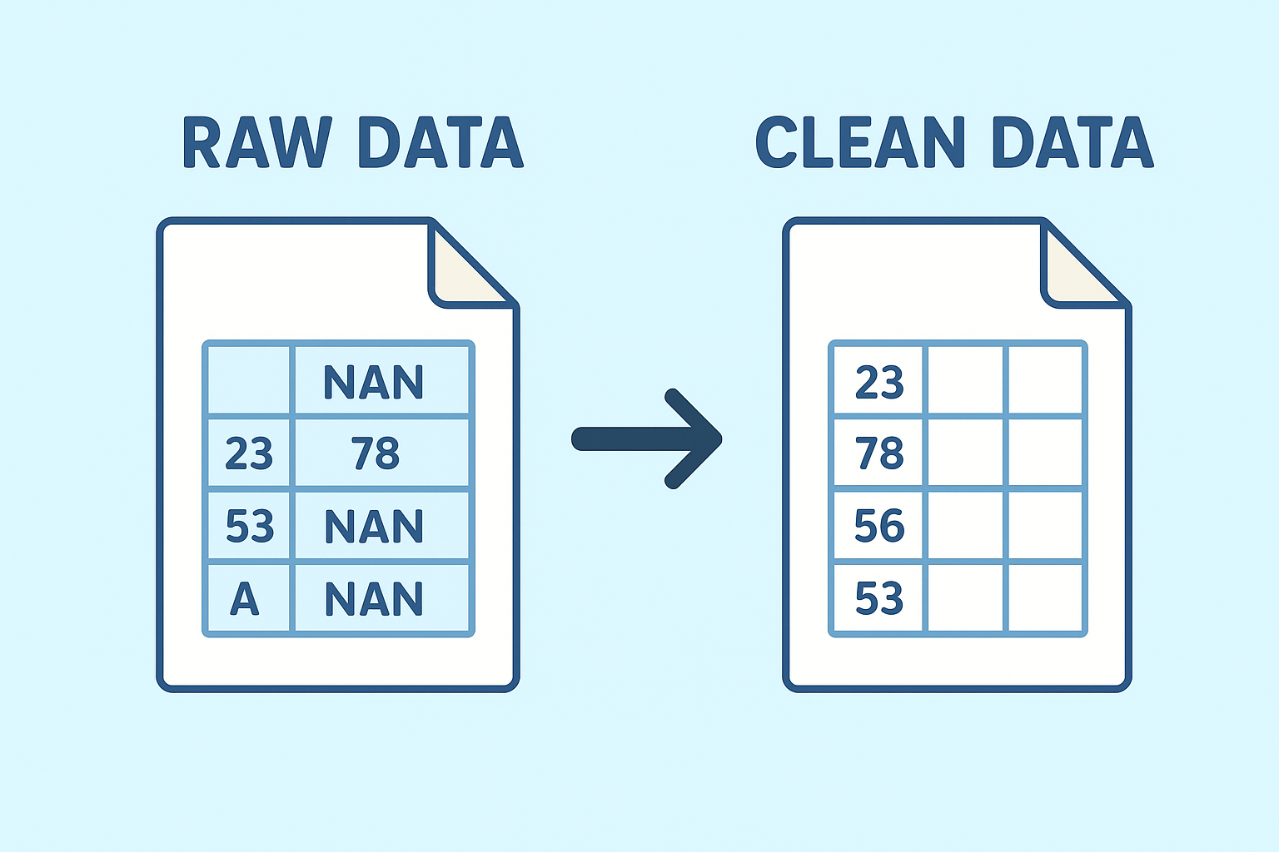
What is data preprocessing
Crucial step in data analytics that involves transforming raw data into a clean and usable format
Process ensures that data is of high quality, free from errors and ready for analysis.

Slide 3
Data quality
Data quality refers to the condition of data and its fitness for particular purpose. High quality data is:
Accurate: Free from errors and inconsistencies
Complete: Contains all the necessary information without missing value
Consistent: Uniform across different database
Timely: Up-to-date and relevant to the current context
Reliable: Data can be trusted for analysis and decision making
Notes:
Example: In a customer database, if the contact information is outdated or incorrect, any marketing campaigns based on this data will likely be ineffective. Ensuring data quality involves verifying and updating this information to ensure it is accurate and reliable.

Slide 4
Why data preprocessing is required?
To ensure good quality of data so that data driven decisions doesn’t go wrong
Data quality is checked on following dimensions
Accuracy: Correctness of data
Completeness: All data is present. Incomplete data lead to gaps in analysis
Consistency: Uniformity of data across datasets
Timeliness: Data is timely updates
Believability: How trustworthy and credible the data is perceived
Interpretability: How easily data can be understood
Notes:
Example: In a healthcare database, the accuracy of patient records is vital. An incorrect blood type recorded in a patient's file could lead to serious medical errors.
Example: In a customer relationship management (CRM) system, missing contact details for clients can prevent effective communication and lead to missed business opportunities.
Example: If a customer’s address is updated in one database but not in another, the inconsistency could result in shipments being sent to the wrong location.
Example: In stock trading, data on market prices must be timely. Using outdated price data could lead to poor investment decisions.
Example: In a news organization, data sourced from an unverified or biased source might be accurate, but it may not be considered believable, affecting the credibility of the reports generated from it.
Example: In a business intelligence tool, if sales data is labeled in cryptic codes or without clear definitions, analysts may misinterpret the data, leading to incorrect conclusions

Slide 5
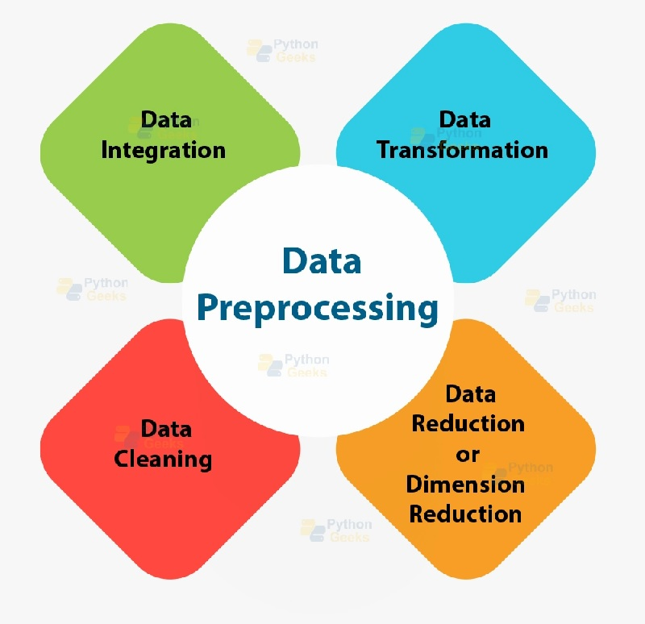
Major tasks in data processing

Slide 6
Data cleaning
Process of detecting and correcting errors
Key steps include
Handling missing data: Filling in missing values with appropriate estimates, or removing records with too many fields
Removing duplicates: Identify and eliminate duplicate records that can skew the analysis
Correcting errors: fixing typographical errors, correcting mis formatted data
Notes:
Example: In a sales database, if the revenue column has some entries as "N/A" or negative values, data cleaning would involve correcting these errors to ensure accurate sales reporting.

Slide 7
Different ways of handling missing values
Ignore the tuple: Works best when amount of data is small. Its is not good when different attributes (or columns) have varying percentages of missing values because you could lose too much important data.
Fill missing values manually: This can be very tedious, especially if you have a large dataset.
Fill missing values Automatically:
Using global constant
Using attribute mean
Notes:
Using a Global Constant:
What it Means: You can replace all missing values with a single constant value, like “unknown” or “N/A.”
Example: If you have a dataset of customer reviews and some customers didn’t provide their age, you could fill in all missing ages with "unknown.“
Challenges: While easy to implement, this might introduce a new "class" or category that could affect the analysis.
Using the Attribute Mean:
What it Means: You replace the missing value with the average value of that particular attribute (column) across all the data points.
Example: If the average age of all customers is 30 years, you could fill in missing ages with 30.
Challenges: This method is simple but might not always be the most accurate, especially if the data is highly variable.

Slide 8
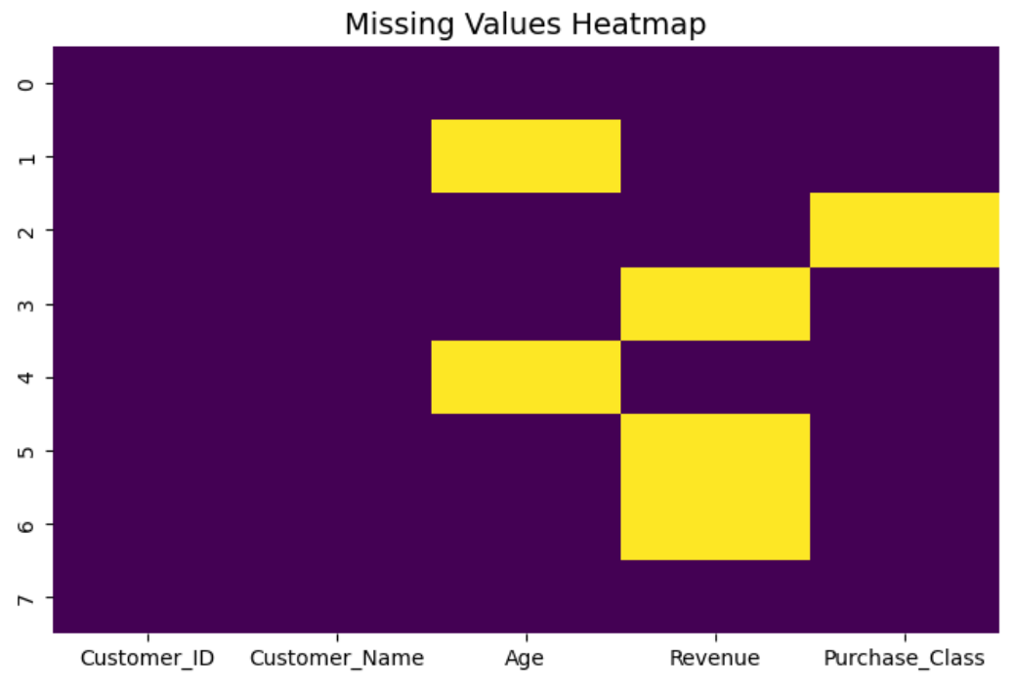
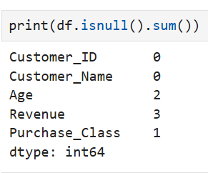

Slide 9
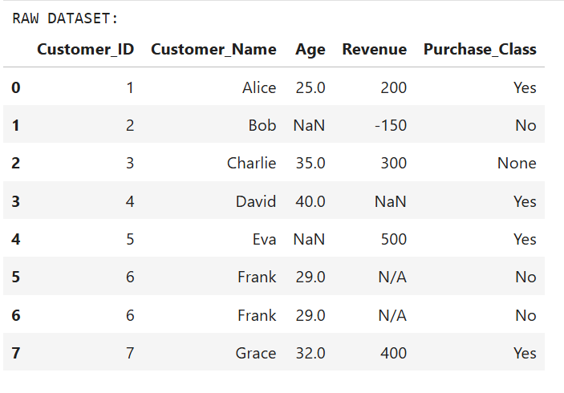
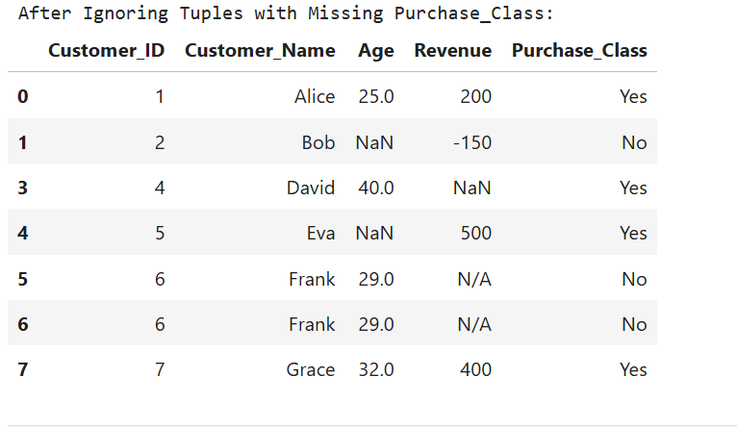
Original data
data after ignoring tuple

Slide 10
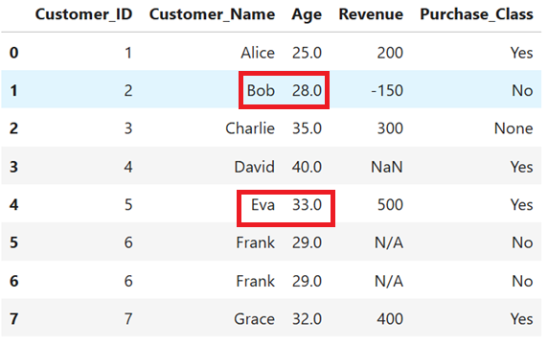
Original data
Fill the missing value manually (here check Age column for Bob and Eva)

Slide 11
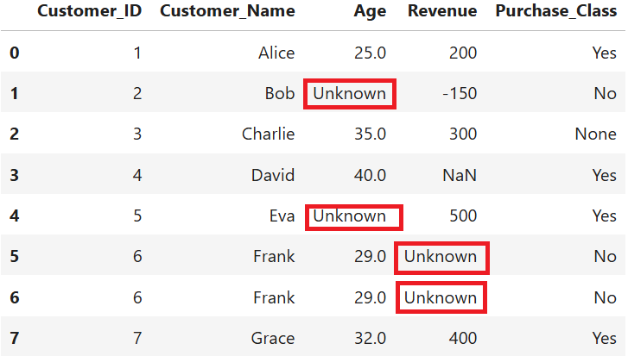
Original data
Fill Missing values Automatically
Global constants

Slide 12
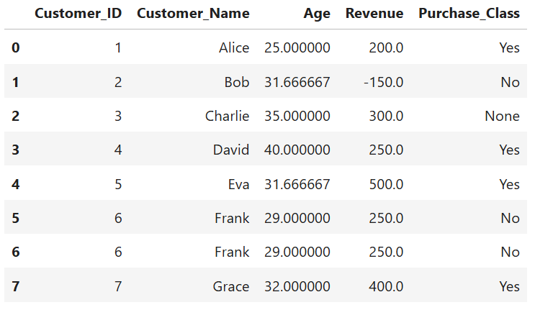
Original data
Fill the missing value with attribute mean
Notes:
Here, missing values in Age are replaced with the overall mean of the entire column.
Example: If the average Age across all customers = 32, then every missing Age will be filled with 32.
Simple and quick, but it ignores the fact that different groups (classes) may have different distributions.

Slide 13
Different ways of handling missing values
Use attribute mean for the same class: Instead of using the average value for the entire dataset, you use the average value only for the data points that belong to the same class (category) as the missing one.
Use Most probable value: Here, you predict the missing value based on other information in the dataset. Techniques like the Bayesian formula or decision trees can be used to infer the most likely value.
Notes:
Using the Attribute Mean for the Same Class:
Example: If you’re predicting whether someone will buy a product (yes/no), and you know that people who say "yes" have an average age of 35, you could fill in the missing age with 35 for someone who has said "yes" in the past.
Advantages: This is a smarter approach because it takes into account the specific class, making it more likely that the filled value is accurate.
Using the Most Probable Value:
Example: If you have other attributes like income, education level, and job type, you could use these to predict the missing age based on patterns in the data.
Advantages: This method is sophisticated and usually more accurate, as it leverages the relationships between different data points.

Slide 14
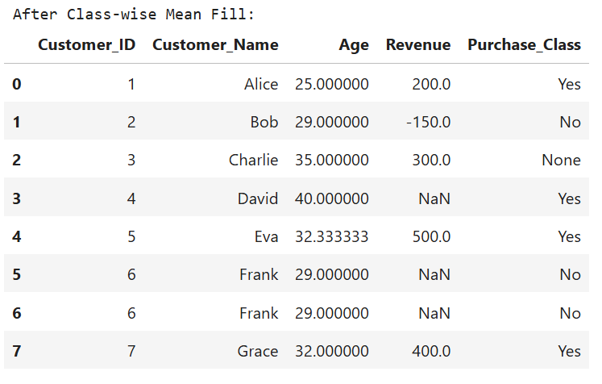
Original data
Fill with Attribute Mean for the Same Class
Notes:
Instead of using the overall mean, it calculates the mean Age within each Purchase_Class (Yes/No).
Missing Age is filled with the average of its own class.
For example:
If buyers (Purchase_Class = Yes) have an average Age of 35, missing values in that group are filled with 35.
If non-buyers (Purchase_Class = No) have an average Age of 28, missing values in that group are filled with 28.

Slide 15
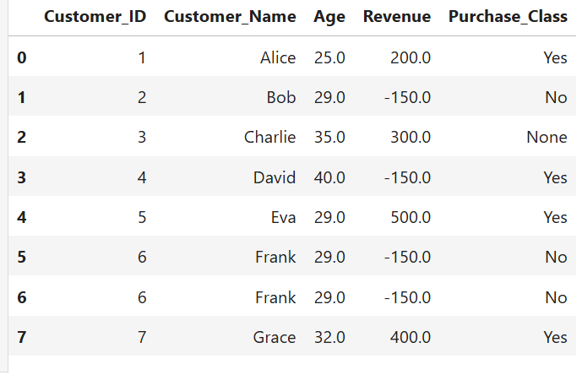
Original data
Fill with Most Probable Value (Mode)

Slide 16
Data cleaning
Data in real world is dirty
Incomplete: lacking attribute values, lacking certain attributes of interest, or containing only aggregate data. e.g., Occupation=“ ” (missing data)
Noisy data: contains noise, errors or outliers. e.g., Salary=“−10” (an error)
inconsistent : containing discrepancies in codes or names, e.g. Age=“42”, Birthday=“03/07/2010”
Intentional (e.g., disguised missing data)

Slide 17
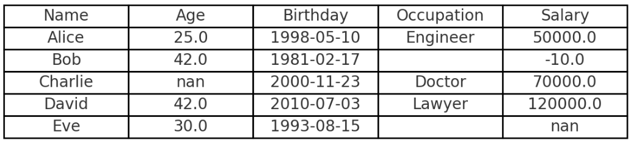
Here’s a sample dataset in Pandas that illustrates:
Incomplete data → Occupation="" or None, Salary=NaN
Noisy data → Salary = -10 (impossible value)
Inconsistent data → Age=42 but Birthday=2010-07-03
Intentional missing data → Occupation left blank on purpose

Slide 18
Reasons of missing data
Data is not always available E.g., many tuples have no recorded value for several attributes, such as customer income in sales data.
Missing data may be due to
equipment malfunction
inconsistent with other recorded data and thus delete
data not entered due to misunderstanding
certain data may not be considered important at the time of entry
not register history or changes of the data

Slide 19
How to handle noisy data
Binning
first sort data and partition into (equal-frequency) bins.
then one can smooth by bin means, smooth by bin median, smooth by bin boundaries, etc
Regression
smooth by fitting the data into regression functions

Slide 20
How to handle noisy data
Clustering
Detect and remove outliers
Example: Daily Step Count of People
Cluster 1: Low activity group (3,000–6,000 steps).
Cluster 2: Moderately active group (7,000–8,000 steps).
Cluster 3: Very active group / athletes (12,000–15,000 steps).
⭐ Outlier: One person with 30,000 steps, which is unusually high compared to all groups.

Slide 21
Numerical
Example: Unsorted data for price prediction
8,16,9,15,21,21,24,30,26,27,30,34
Solution:

Slide 22
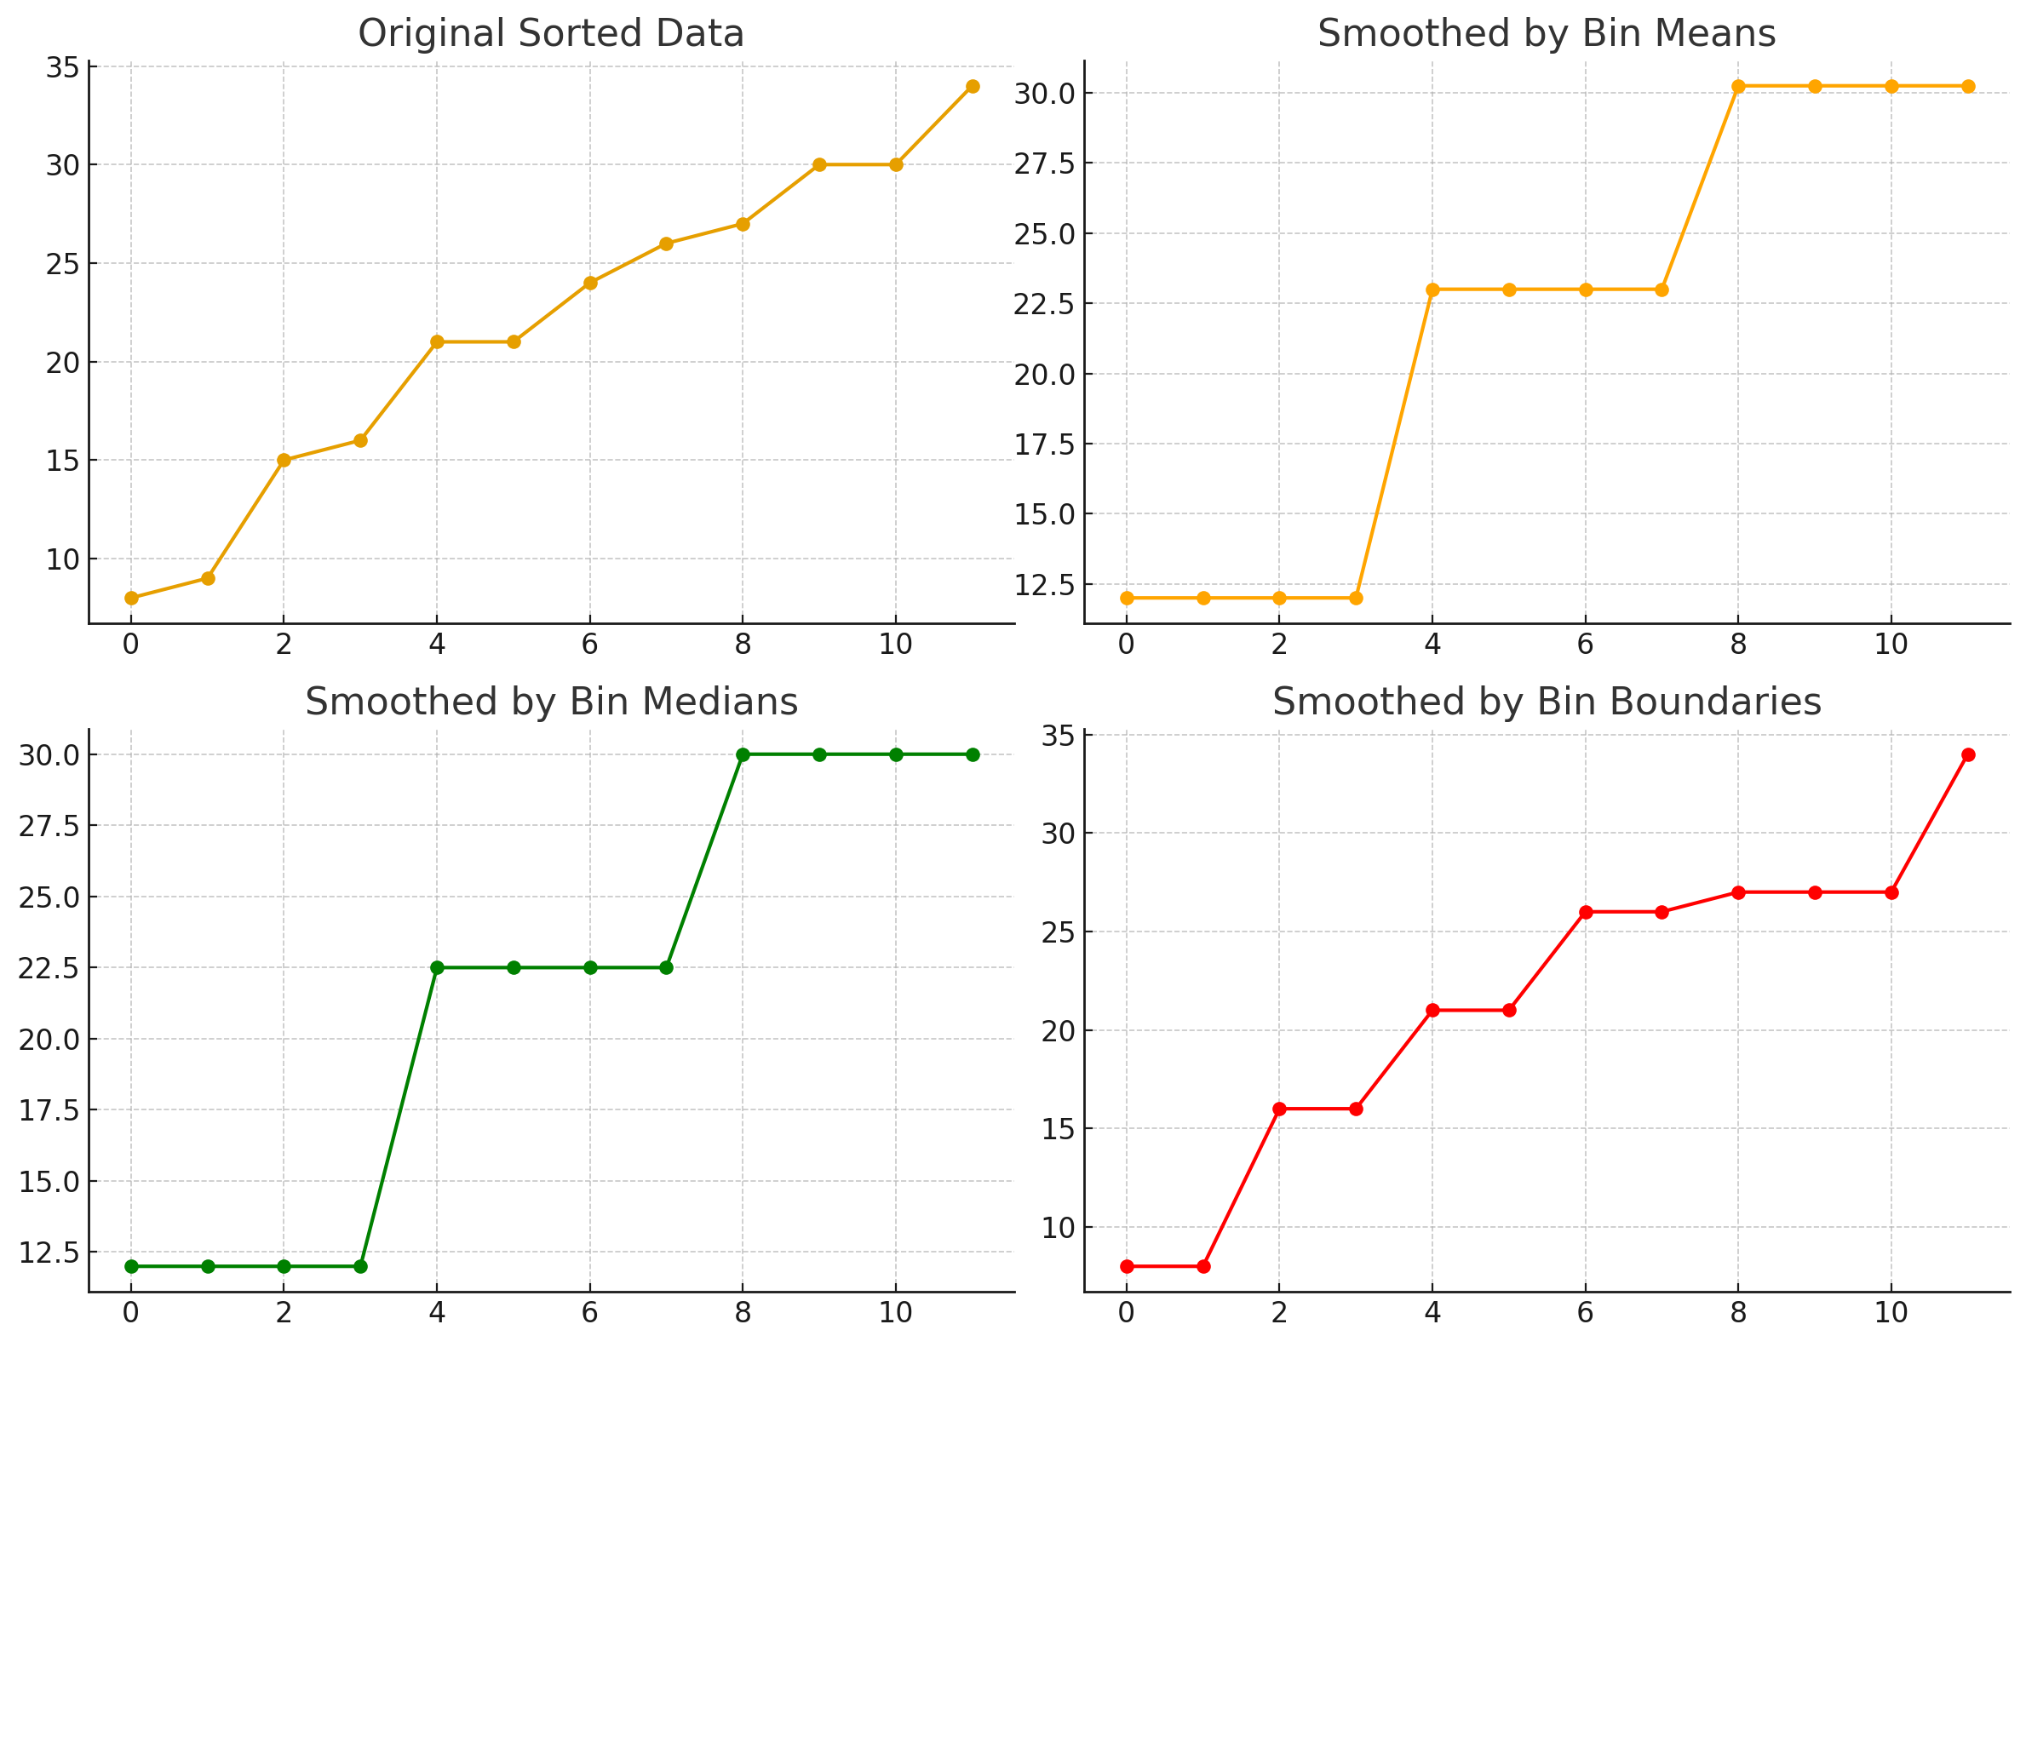
Here’s the visual comparison 👇
Top-left: Original sorted data (noisy)
Top-right: Smoothed by Bin Means (values averaged per bin)
Bottom-left: Smoothed by Bin Medians (middle value per bin)
Bottom-right: Smoothed by Bin Boundaries (values snapped to nearest bin edge)
This shows how binning reduces fluctuations and smooths the dataset.

Slide 23
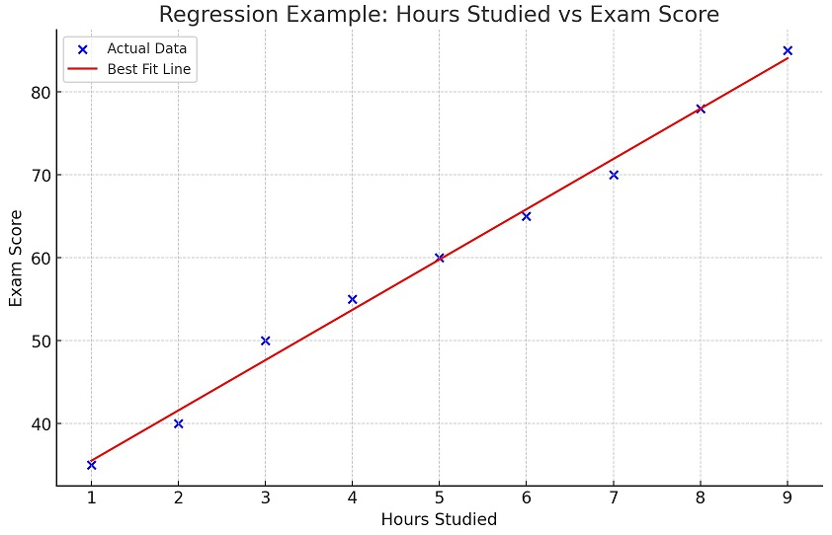
Regression
Here’s a simple day-to-day example of regression:
Example: Hours studied vs Exam Score
The blue dots represent actual student exam scores based on hours studied.
The red line is the best fit regression line, showing the general trend.
This line smooths the data and helps predict exam scores for any given study time.

Slide 24
Data cleaning as a process
Data discrepancy detection
Use metadata (e.g., domain, range, dependency, distribution)
Check field overloading
Check uniqueness rule, consecutive rule and null rule
Use commercial tools
Data scrubbing:
Data auditing

Slide 25
Data migration and integration
Data migration tools: allow transformations to be specified
ETL (Extraction/Transformation/Loading) tools: allow users to specify transformations through a graphical user interface
Integration of the two processes
Iterative and interactive (e.g., Potter’s Wheels)

Slide 26
Data Integration
Data Integration
Process of combining data from different sources
Schema integration
Matching up the structure of different databases so that they can work together
Detecting and resolving data value conflicts
For the same real-world entity, attribute values from different sources are different

Slide 27
Handling redundancy in data integration
Redundant data occur often when integration of multiple databases
Object identification: The same attribute or object may have different names in different databases
Derivable data: One attribute may be a “derived” attribute in another table, e.g., annual revenue
Redundant attributes may be able to be detected by correlation analysis and covariance analysis
Careful integration of the data from multiple sources may help reduce/avoid redundancies and inconsistencies and improve mining speed and quality

Slide 28
Data Reduction
Data reduction: Obtain a reduced representation of the data set that is much smaller in volume but yet produces the same (or almost the same) analytical results.
Why data reduction? — A database/data warehouse may store terabytes of data. Complex data analysis may take a very long time to run on the complete data set

Slide 29
Data reduction strategies
Dimensionality reduction, e.g., remove unimportant attributes
Wavelet transforms
Principal Components Analysis (PCA)
Feature subset selection, feature creation
Numerosity reduction (some simply call it: Data Reduction)
Regression and Log-Linear Models
Histograms, clustering, sampling
Data cube aggregation

Slide 30
Data Transformation
A function that maps the entire set of values of a given attribute to a new set of replacement values s.t. each old value can be identified with one of the new values
Methods
Smoothing: Remove noise from data
Attribute/feature construction
Aggregation: Summarization, data cube construction

Slide 31
Data Transformation
Normalization: Scaled to fall within a smaller, specified range
min-max normalization
z-score normalization
normalization by decimal scaling

Slide 32
Normalization
House | Square foot | Bedrooms | Price(in Lakhs)
1 | 1200 | 3 | 50
2 | 1500 | 4 | 60
3 | 1000 | 2 | 40
4 | 1800 | 5 | 80

